Slide 1

RIFAT ALA
Survey on Federated-Learning Approaches in Distributed Environment
Submitted by: Rifat Alam Pomil
ID: 23266028
Department: CSE
Course ID: CSE707
Course Name: Distributed Computing System
Submitted to:
Annajiat Alim Rasel
Senior Lecturer, BRAC University

Slide 2
INTRODUCTION
Exploring Federated Learning in Distributed Environments
Motivation: Growing significance of Federated Learning (FL) in IoT networks, wireless communication networks, and machine learning.
Purpose: To shed light on various aspects of FL, with a focus on privacy preservation and data prediction.
Aims: Understand FL approaches and their potential applications, emphasizing data privacy.
Hypothesis: FL can securely unite multiple organizations, ensuring data privacy and equitable benefits.

Slide 3
Motivation
Growing Significance of FL:
Acknowledging the increasing importance of Federated Learning (FL) in diverse technological domains.
Motivation in Technological Trends:
Driven by the evolving landscape of IoT networks.
Responding to the pivotal role of FL in wireless communication networks.
Recognizing FL's integration into the fabric of machine learning advancements.
Focused Exploration:
Aimed at shedding light on the multifaceted aspects of FL.
Exploring potential applications with a spotlight on privacy preservation and data prediction.
Hypothesis and Security Considerations:
Hypothesizing FL's ability to securely bring together multiple organizations.
Emphasizing the crucial aspects of data privacy and ensuring fair benefits for all participants.

Slide 4
Contributions
Key Contributions:
Overview of FL approaches (centralized, decentralized, heterogeneous).
Exploration of privacy-preserving mechanisms.
Emphasis on optimization using blockchain-based FL approaches.
Potential for revolutionizing secure data sharing.

Slide 5
Methodology
Comprehensive review of FL in distributed systems.
Exploration of various FL approaches, privacy preservation, optimization, and applications.
Rely on surveys and critical analysis for an informative overview.

Slide 6
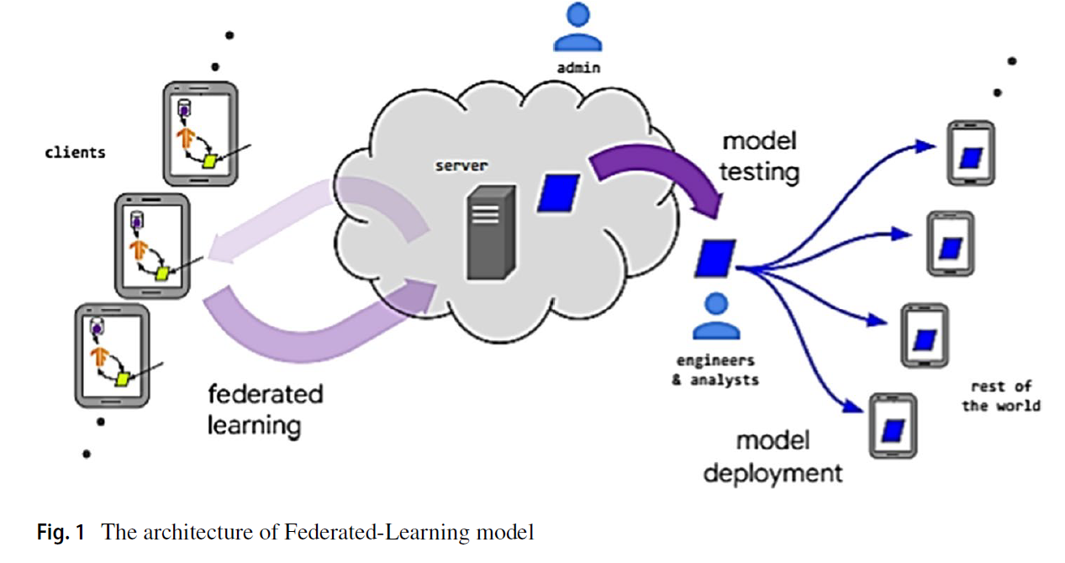
Figure-1

Slide 7
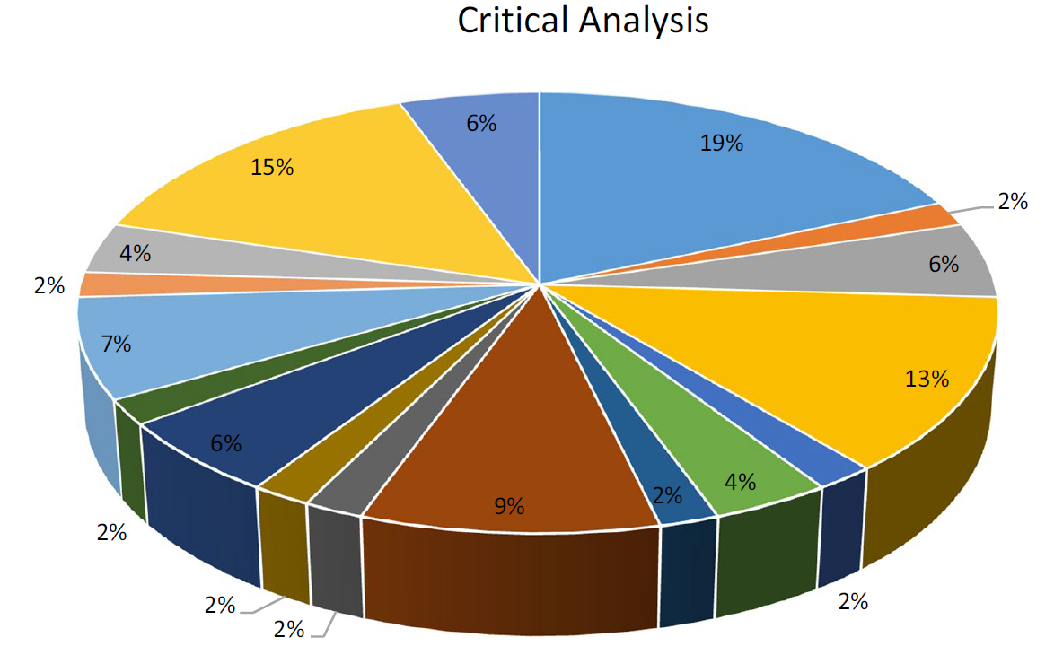
Final Result

Slide 8
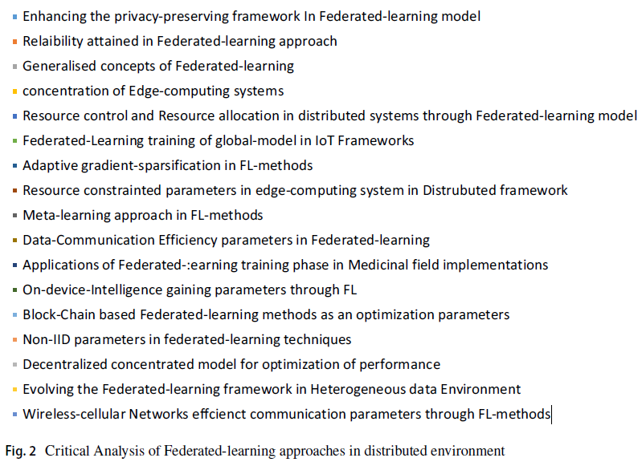
Final Result

Slide 9
CONCLUSION
Growing importance of FL in various sectors.
Acknowledgment of challenges and limitations.
Potential of FL in bridging the gap between organizations, ensuring data privacy and equitable benefits.

Slide 10
First Limitation
Computational and Statistical ChallengesHeterogeneous Data
Heterogeneous Data Distributions:
Highlighting challenges linked to diverse data distributions.
Acknowledging the impact of computational and statistical hurdles.
Addressing Challenges:
Introduction of a statistical framework to tackle identified issues.
Acknowledging the potential need for further refinement.

Slide 11
Second Limitation
RL-Based Centralized Server Approach
Data Heterogeneity Determination:
Utilizing a centralized server approach based on Reinforcement Learning (RL).
Focusing on determining and optimizing performance in Federated Learning (FL).
Feasibility Concerns:
Acknowledging the promising nature of the RL-based approach.
Identifying the need for further investigation, especially in multi-coalition scenarios.

Slide 12
Synthesis
FL's growing importance in IoT, wireless communication, and machine learning.
Emphasis on secure data sharing and privacy preservation.
Potential applications and efficiency of FL for data prediction.
Promise of FL in bridging the gap between organizations and ensuring equitable benefits.

Slide 13
THANK YOU!

